Slide 1

Internet Information Server
Team Members:
Hung Duong
Hak Gauv
Eric Luc
David Nguyen
Larry Tan

Slide 2

Internet Information Server
Introduction
Features
Competition
Additional Resources

Slide 3
Introduction
What is IIS?
Purpose of an IIS
Differences between 4.0 and 5.0 versions

Slide 4
What is IIS?
IIS is a protocol server.
It is implemented as a set of several system services that use the most common Internet protocols including HTTP, FTP, NTTP and SMTP.
The Microsoft IIS is built into the Microsoft Windows NT Server operating system.

Slide 5
Purpose of an IIS
The Microsoft Internet Information Server is designed to deliver high speed and secure information publishing, while also serving as a platform for developers and independent software vendors to extend the Internet’s standard communication capabilities.

Slide 6
Differences Between 4.0 and 5.0
Administration: Applications can now be grouped into pooled processes for increased performance and improved scalability
Security: Many of the security features available in IIS 4.0 have been simplified in IIS 5.0, which has new security task wizards
Performance: Socket pooling has been enabled to decrease memory use and increase performance

Slide 7

Features of IIS 5.0

Slide 8

Security
Digest Authentication
Secure Communications
Server-Gated Cryptography
Kerberos v5 Authentication Protocol Compliance

Slide 9
Administration
Restarting IIS
Backing up and restoring IIS
Improved Custom Error Messages
Remote Administration
Terminal services
Centralized Administration

Slide 10
Programmability
Active Server Pages
  Create dynamic content
  Provides an alternative to CGI and ISAPI
  Provides access to all of the HTTP request and response streams, as well as standards-based database connectivity
  The ability to customize content for different browsers

Slide 11
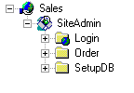
Programmability (cont.)
Application Protection
  Starting-Point
    The default Web site that is created when you install Internet Information Services is an application starting point.
    An application can share information among the files in the application.

Slide 12
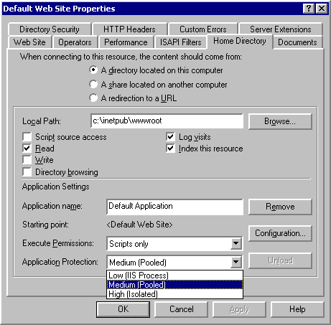
Protection
Application protection refers to the process in which applications are run.
IIS 5.0 offers three levels of application protection.
applications can be run in a pooled process (another instance of DLLHost.exe).

Slide 13
Performance
There is a trade-off between performance and level of application protection.
The recommended configuration is to run inetinfo.exe in its own process, run mission-critical applications in their own processes, and run remaining applications in a shared, pooled process.

Slide 14
Programmability (cont.)
ADSI 2.0
- Administrators and Application developers have the ability to add custom objects, properties, and methods to the existing ADSI provider, giving more flexibility.

Slide 15
Internet Standards
Standards Based
  Complies with the HTTP 1.1 standard, including features such as PUT and DELETE
  The ability to customize HTTP error messages, and support for custom HTTP headers
Multiple Sites, One IP address
  Host multiple Web sites on a single computer running Win2000 Server with only one IP address
News and Mail
  - Use SMTP and NNTP Services to set up intranet mail and news services that work in conjunction with IIS

Slide 16
Internet Standards (cont.)
PICS Ratings
  Apply Platform for Internet Content Selection ratings to sites that contain content for mature audiences.
Web Distributed Authoring and Versioning
  - Enable remote authors to create, move, or delete files, file properties, and directory properties on your server over an HTTP connection.

Slide 17
Internet Standards (cont.)
FTP Restart
  File Transfer Protocol file downloads can be resumed without having to download the entire file over again if an interruption occurs during data transfer.
HTTP Compression
  Provides faster transmission of pages between the Web server and compression-enabled clients.
  Compresses and caches static files, and performs on-demand compression of dynamically generated files.

Slide 18
Distributed Authoring and Versioning (WebDAV) Support
Allows multiple people collaborate on a document using an Internet-based shared file system
Addresses issues such as file access permissions, offline editing, file integrity, and conflict resolution when competing changes are made to a document
Expands and organization’s infrastructure by using the Internet as a central location for storing shared files.

Slide 19
Microsoft Active Server pages (ASP)
ASP provides an easy-to-use alternative to Common Gateway Interface (CGI) and Internet Server Application Program Interface (ISAPI) by allowing content developers to embed any scripting language or server component into their HTML pages
ASP now senses when executing requests are blocked by external resources and automatically provides more threads to simultaneously execute additional requests while continuing processing
ASP also includes new script encoding utility using Vbscript and Microsoft Jscript 5.0

Slide 20
FrontPage Server Extensions Support
With FrontPage Server extensions, administrators can view and manage a Web site through a graphical interface
Creating Web sites with FrontPage Web site creation and management tool is as easy as clicking a check box on a property page for the Web Site
Authors can create, edit and post Web pages to IIS remotely

Slide 21
Fortezza
IIS 5.0 supports U.S. government security standard
This standard satisfies the Defense Message System security architecture with a cryptographic mechanism that provides message confidentiality, integrity and authentication
Implementation by both server browser software and PCMCIA card hardware

Slide 22

Competition for IIS

Slide 23
Web Server Competition
Apache
  Linux
  Costs around $180, but can be downloaded for free from Red Hat website
iPlanet
  Solaris
  Costs around $1,500
Internet Information Server
  Windows 2000
  Costs about $800 for Windows 2000 license

Slide 24
Performance
Speed
  IIS serves up static documents a little faster than iPlanet, while Apache lags behind both.
  Both IIS and iPlanet exhibit excellent speed.
  Apache’s lag is due to its lack of multithreading and the scalability problems of Linux.
  In terms of CGI-Bin processing, Apache performed very well. iPlanet performed slow, and IIS is somewhat sluggish and occasionally inconsistent.

Slide 25
Performance (cont.)
Stability
  Due to Windows 2000 user-friendly interface, it is easy for experienced admin to fine-tune and manage an IIS Web server, which can make it very reliable
  An experience admin can set up iPlanet or Apache to be bulletproof and still experience better uptime than an optimized IIS server can achieve

Slide 26
Performance (cont.)
Scalability
  iPlanet on Solaris currently blows away both IIS and Apache
  IIS does scale respectably, and it supports clustering and symmetrical multiprocessing (SMP)
  Apache on Linux doesn’t scale very well due to limitations of Linux in enterprise computing
  Apache can scale fairly well on more robust operating systems such as Solaris

Slide 27
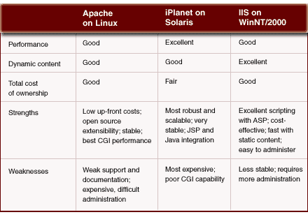
How do the platforms stack up?

Slide 28
It Additional Resources
www.microsoft.com
www.iisanswers.com
www.iistraining.com

